Slide 1
How
Sugar Creek Elementary
Became the First School in South Carolina
to Organize…
ONE
SCHOOL ONE
BOOK
Families Reading
T O G E T H E R
Every Day
Kim C. Nees, MLIS
neesk@fort-mill.k12.sc.us

Slide 2
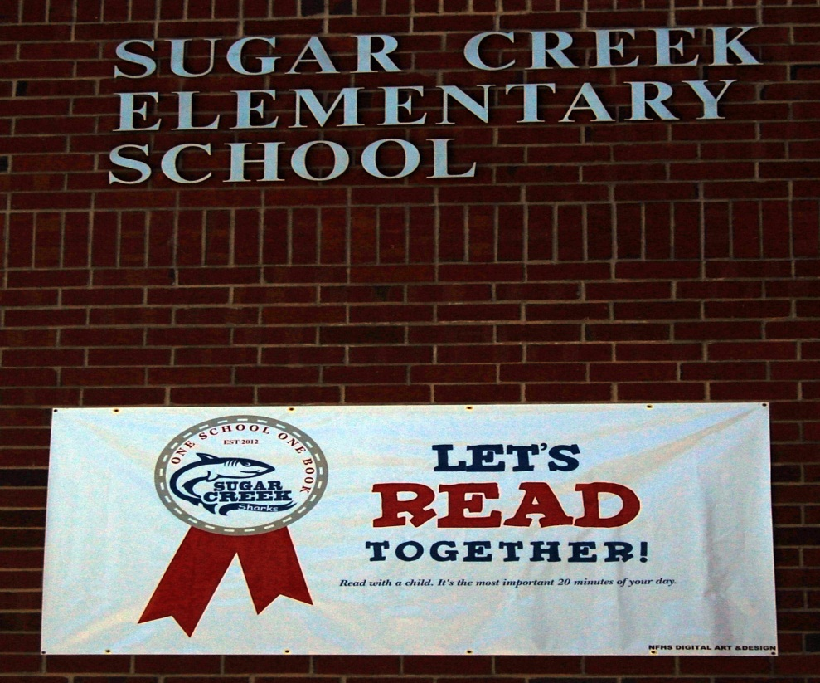
What is it? Annual Family Literacy Initiative Created by Read to Them Foundation
Unite an entire school community of parents, teachers, staff and students by choosing a single chapter book to
read, aloud TOGETHER at home, over the course of one month.
readtothem.org

Slide 3
What's the Point? Encourage parents to READ ALOUD to their children everyday
Children who are read to at home, read more on their own.
Children who are read to at home or at school make superior gains in reading comprehension and vocabulary.
Its never too late!
Researchers also recommends reading aloud to
middle and high school students to help
improve literacy skills.
Krashen (2004)
Zehr (2010)

Slide 4
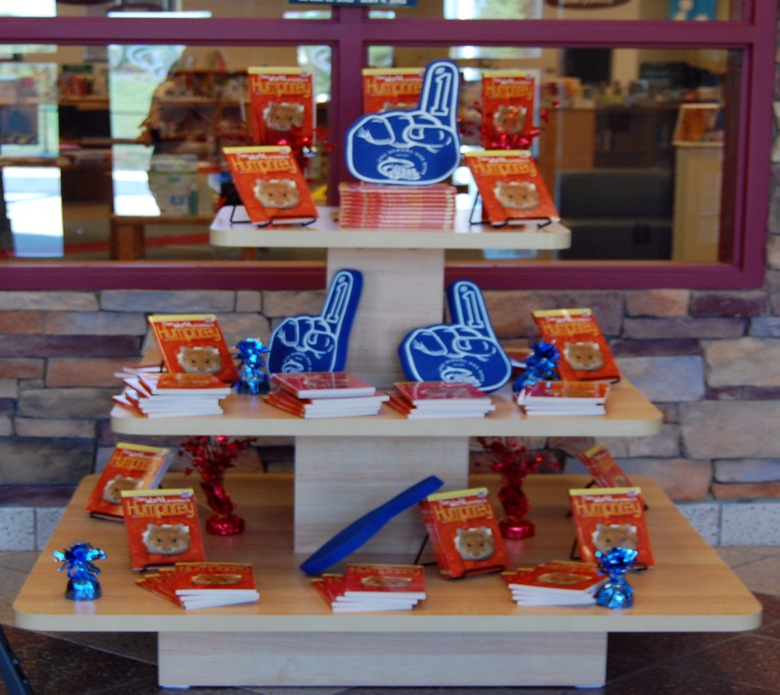
How to Make it Happen In 5 easy steps…
Join Read To Them Foundation
Form a committee
Choose a book
Communicate
READ
Have Fun!!

Slide 5
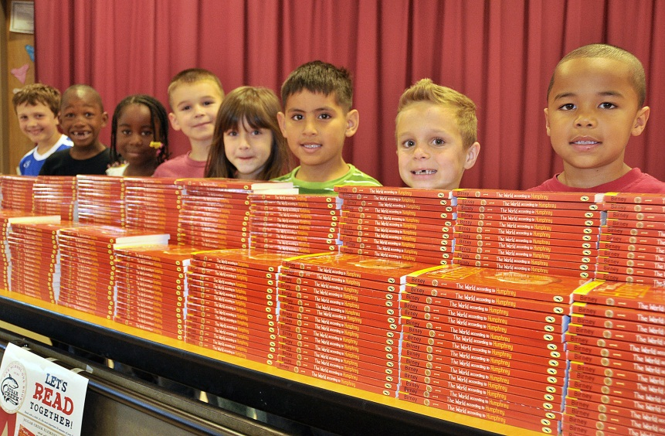
Step 1: Join Read to Them
Lifetime Membership is $500.00 (Think GRANT!)
Provide scripts, sample trivia, book recommendations
Significant discounts on recommended titles
We saved over $1500.00 on 700 books

Slide 6
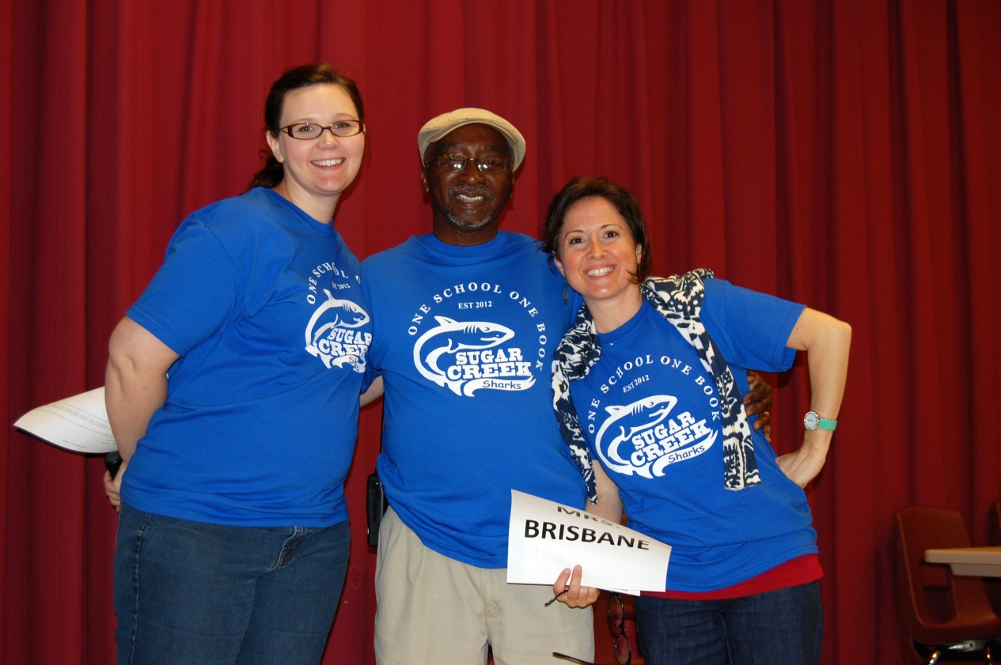
Step 2: Form a Committee
Once you have your principal on board………..
Literacy Facilitator, Vice Principal, ESL Coordinator, Media Specialist

Slide 7
Step 3: Choose a Book
The Trumpet of the Swan, by E.B. White
The Indian in the Cupboard, by Lynne Reid Banks
Because of Winn-Dixie, by Kate DiCamillo
The BFG, by Roald Dahl
Love That Dog, by Sharon Creech
Heartbeat, by Sharon Creech
Mrs. Frisby and the Rats of NIMH, by Robert C. O'Brien
Shiloh, by Phyllis Reynolds Naylor
Dominic, by William Steig
A Cricket in Times Square, by George Selden
Frindle, by Andrew Clements
A Barrel of Laughs, A Vale of Tears, by Jules Feiffer
Bud, Not Buddy, by Christopher Paul Curtis
The Miraculous Journey of Edward Tulane, by Kate DiCamillo
Island of the Blue Dolphins, by Scott O'Dell
In the Year of the Boar and Jackie Robinson, by Bette Bao Lord
The World According to Humphrey, by Betty G. Birney
My Side of the Mountain, by Jean Cragihead George
The Lion, the Witch, and the Wardrobe, by C.S. Lewis
The Lemonade War, by Jacqueline Davies
The Enormous Egg, by Oliver Butterworth

Slide 8
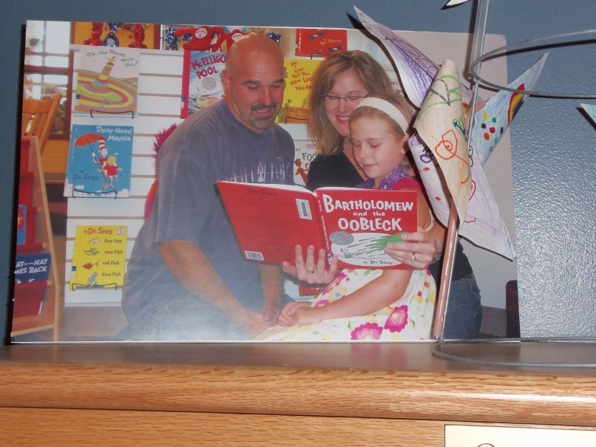
Step 4: Communicate
Meet with teachers
Kick-off assembly
All-call announcements
Create a logo
Letter
Posters
Invitation to district officials
Photos of teachers reading to their children
Notes:
Meet with teachers, NO WORK!

Slide 9
Logo
Notes:
ESTablished 2012

Slide 10
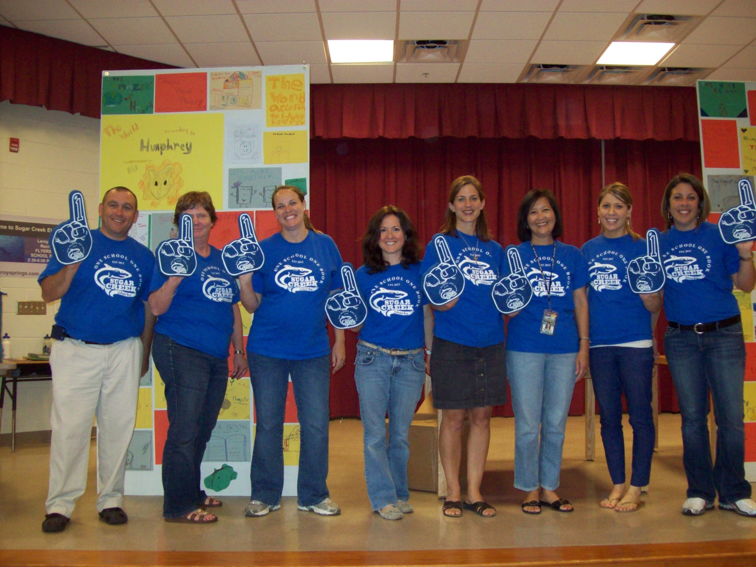
T-shirts
Notes:
Wear the same Tshirts year after year…

Slide 11
Banner
ALL OF OUR GRAPHICS WERE DESIGNED BY PARENT VOLUNTEERS!

Slide 12
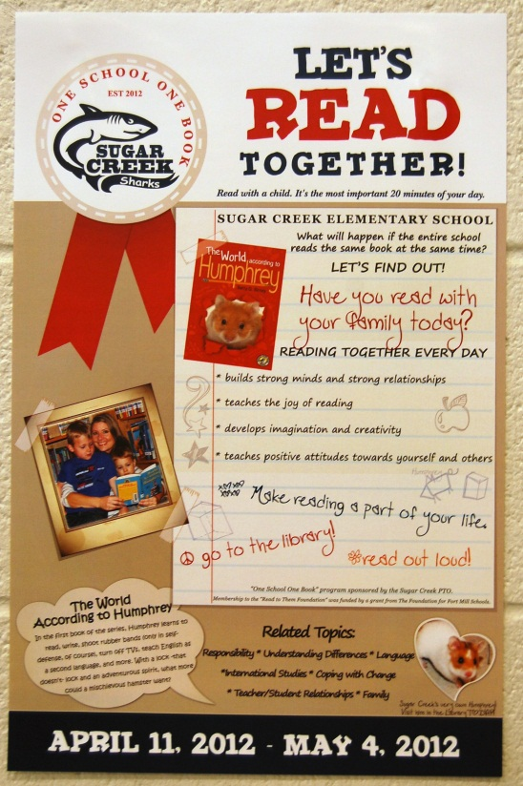
Posters
Notes:
These posters were hung everywhere!

Slide 13
Invitations for VIP
Notes:
We had several district employees attend the assembly skit. This will help spread the word about the program.

Slide 14
Email Invitation

Slide 15
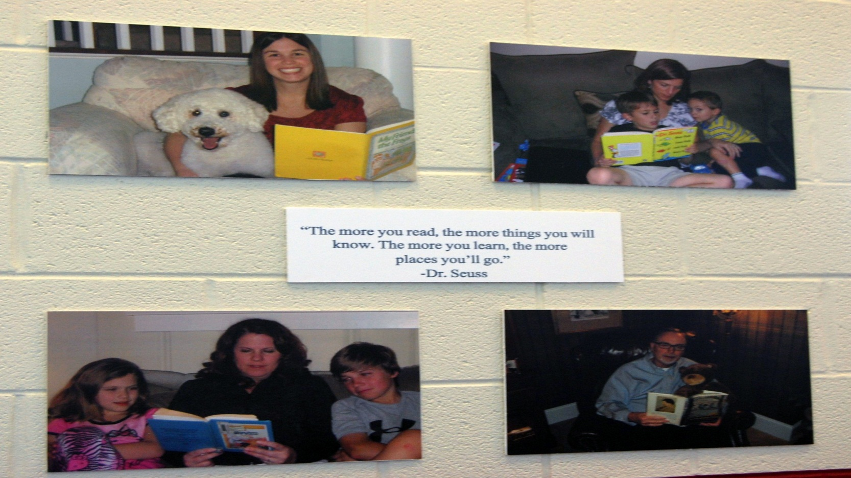
Modeling Posters

Slide 16
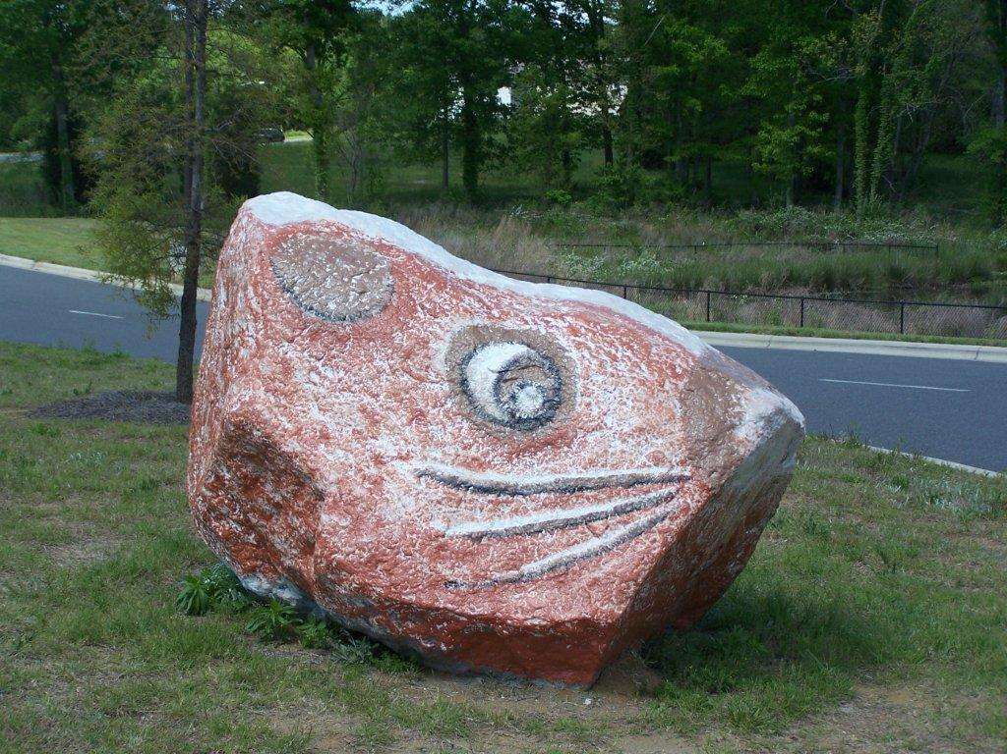
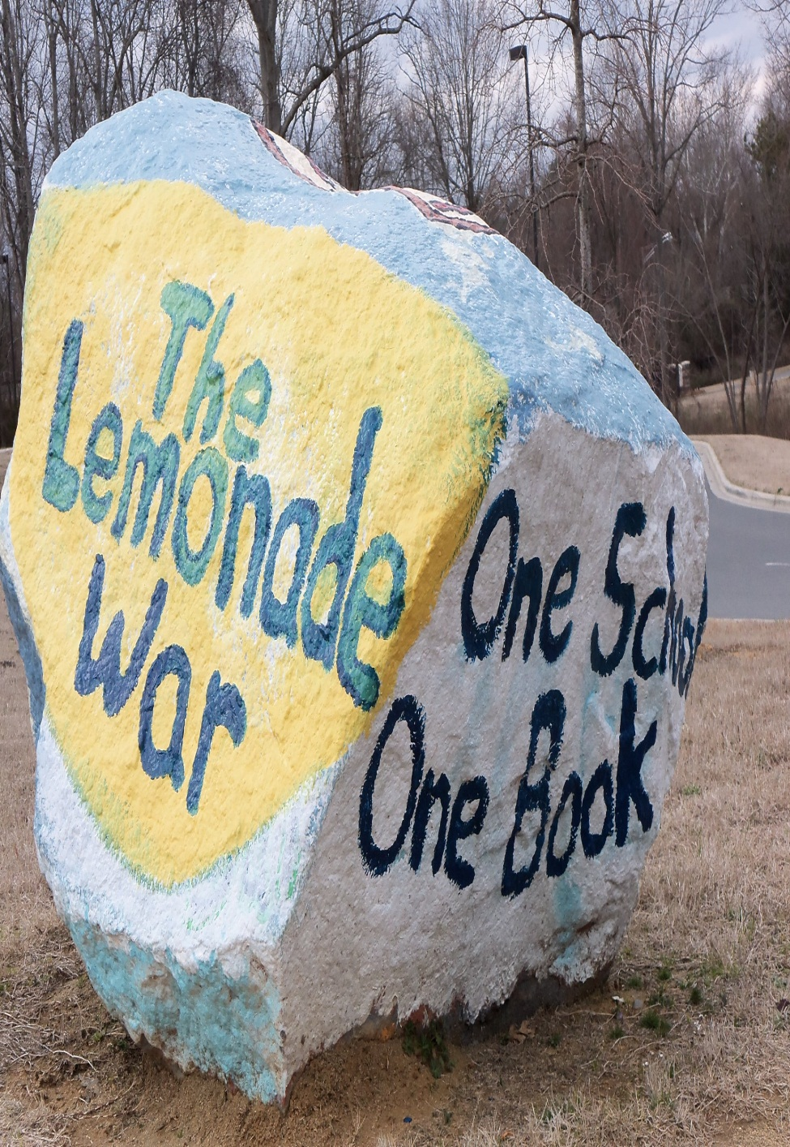
Paint the Rock

Slide 17
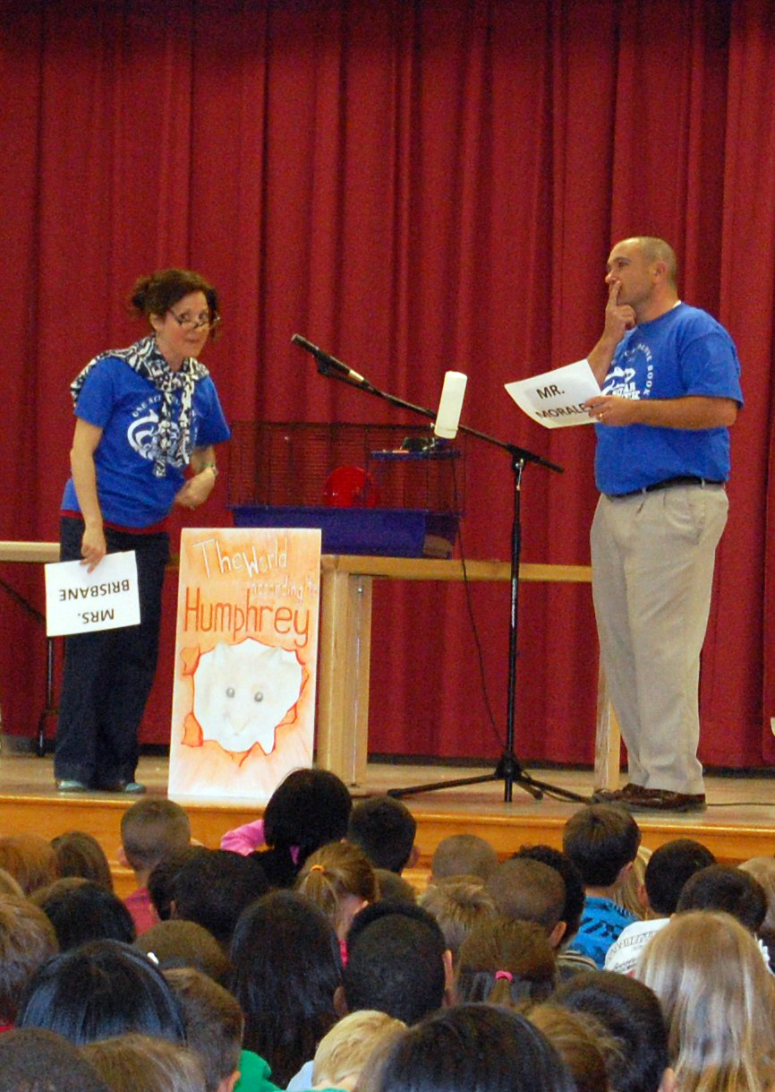
Assembly Skit
Notes:
Principal, Custodian and Media Specialist played the three main characters in the book

Slide 18
Assembly Skit

Slide 19
Modeling
Notes:
Teachers got on stage with their children to model the read aloud concept

Slide 20
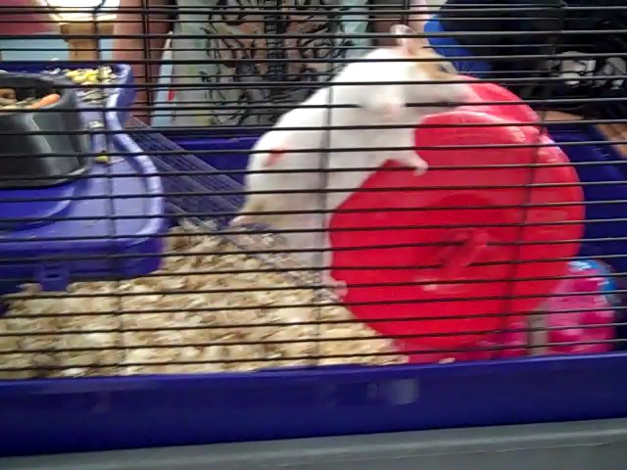
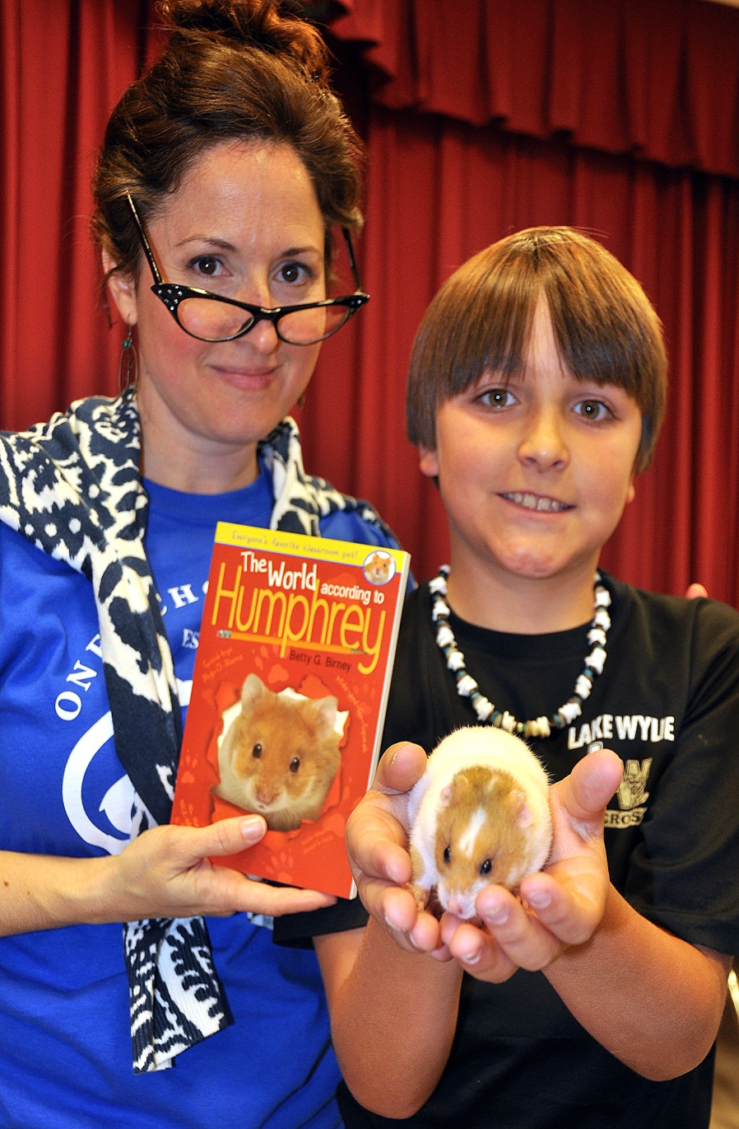
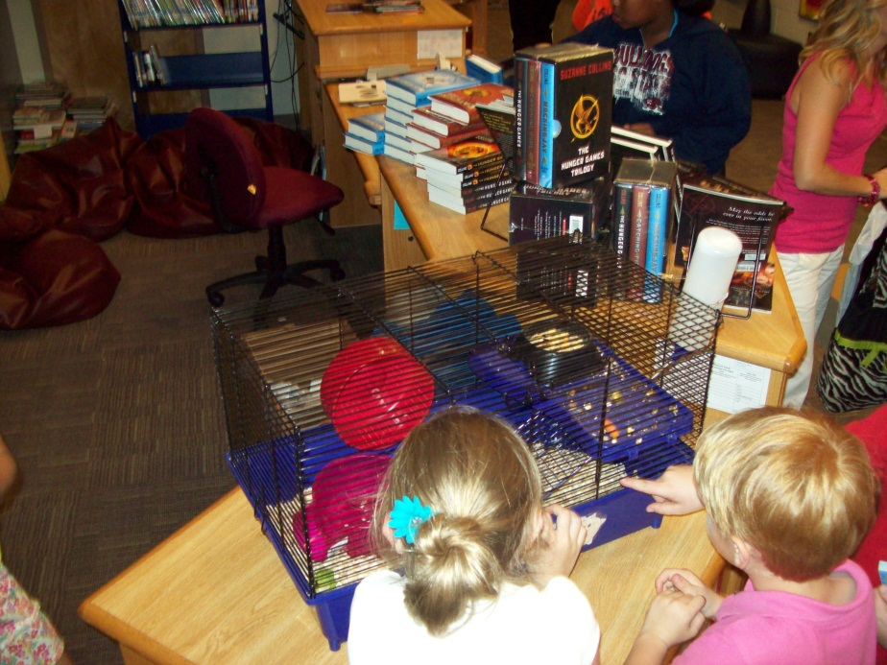
Humphrey
Notes:
Yes, a LIVE Hamster! He has since been adopted by a very NICE family!

Slide 21
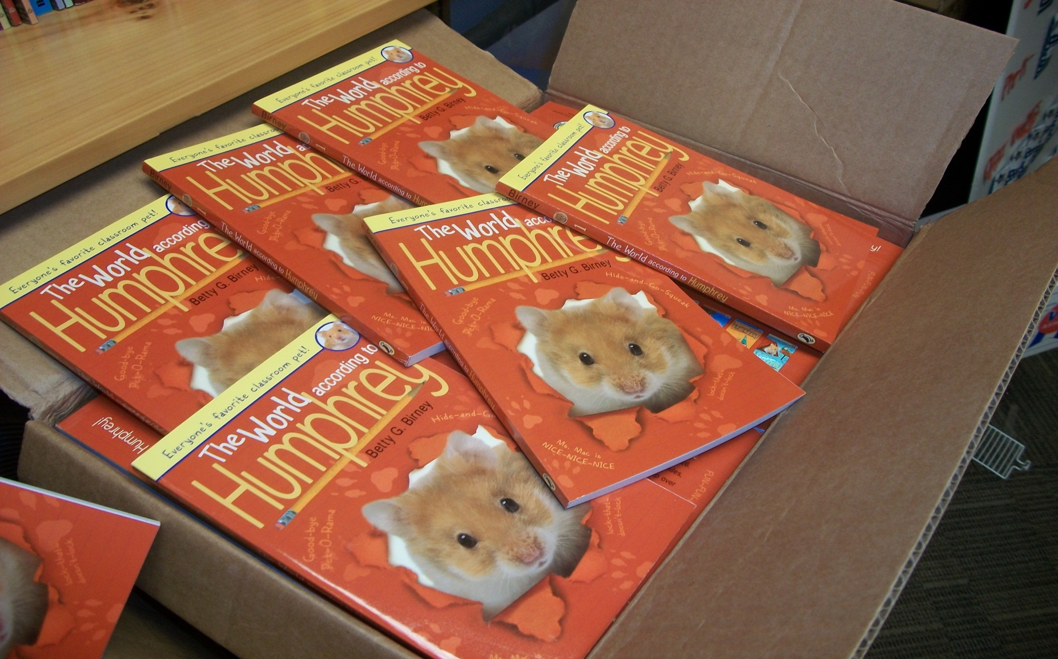
Step 5: READ!
Notes:
Each family got a book (the book was passed out to the youngest child). Also every staff member at the school got one.

Slide 22
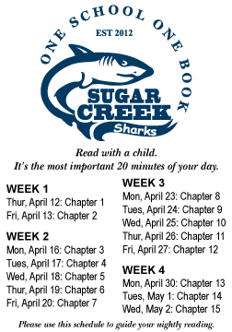
Schedule
Notes:
Sticker was on the inside cover of each book to keep families on track

Slide 23
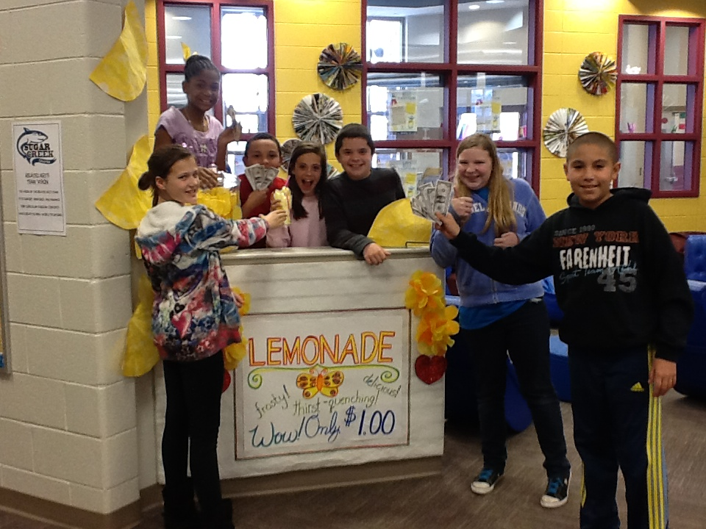
Build the Hype!
Afternoon announcements
All call announcements
Morning news show
Book fair & parent education night
Media center & classroom projects
Great opportunity for collaboration Art, Music, Technology, PE
Trivia
Prizes

Slide 24
Daily Trivia
Notes:
Trivia was announced on morning announcements each day

Slide 25
Prizes!
Notes:
The kids loved these foam fingers!

Slide 26
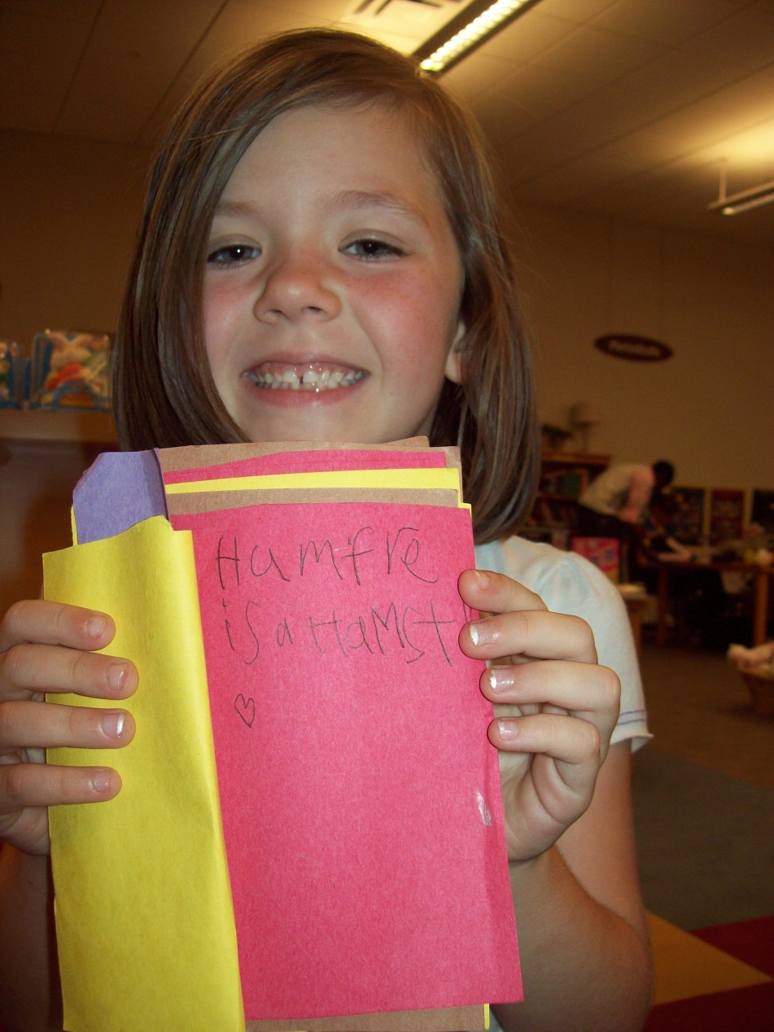
Creativity
Notes:
We wrote books about and for Humphrey and made tons of posters to decorate the school.

Slide 27
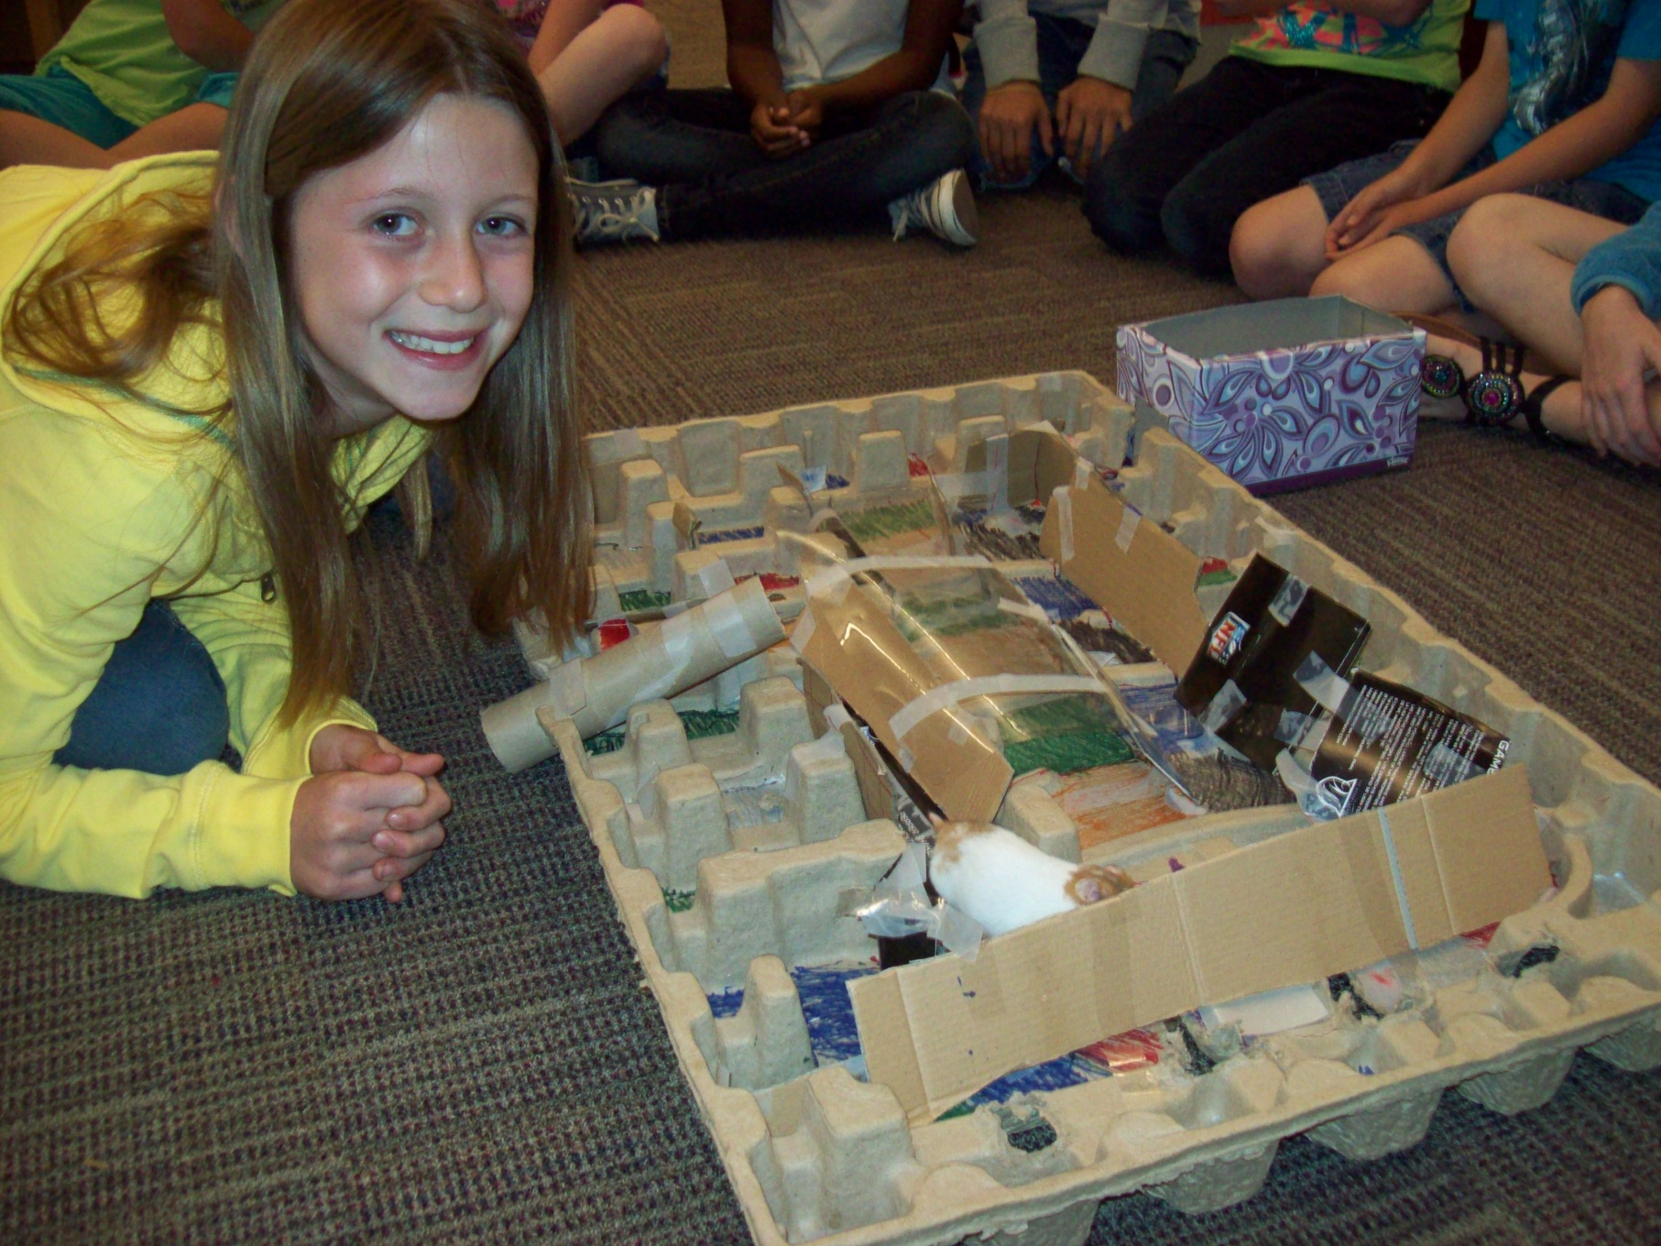
aMAZEing!
Notes:
Kids offered to build mazes for Humphrey this is one of them.

Slide 28
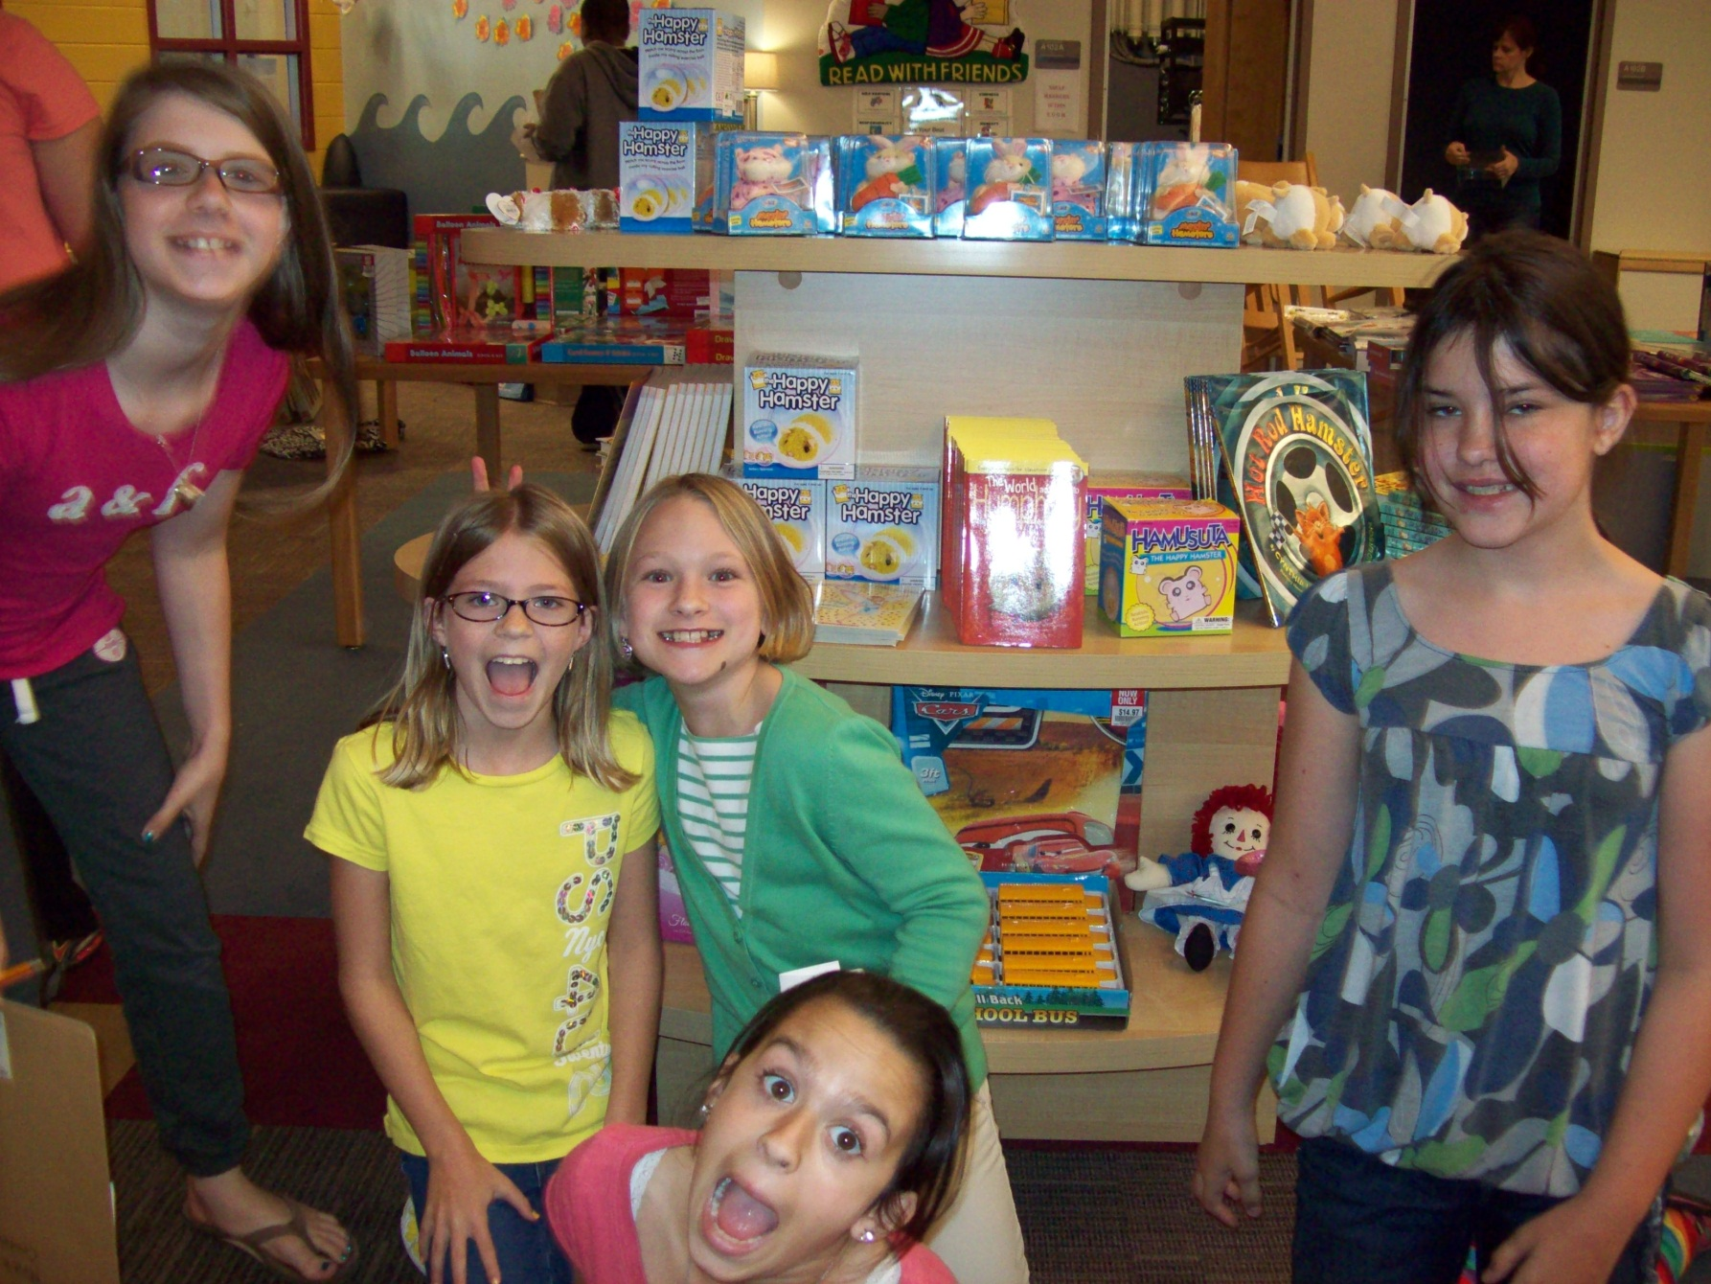
Book Fair
Notes:
Hamster items sold-out!! Family Night during book fair.

Slide 29
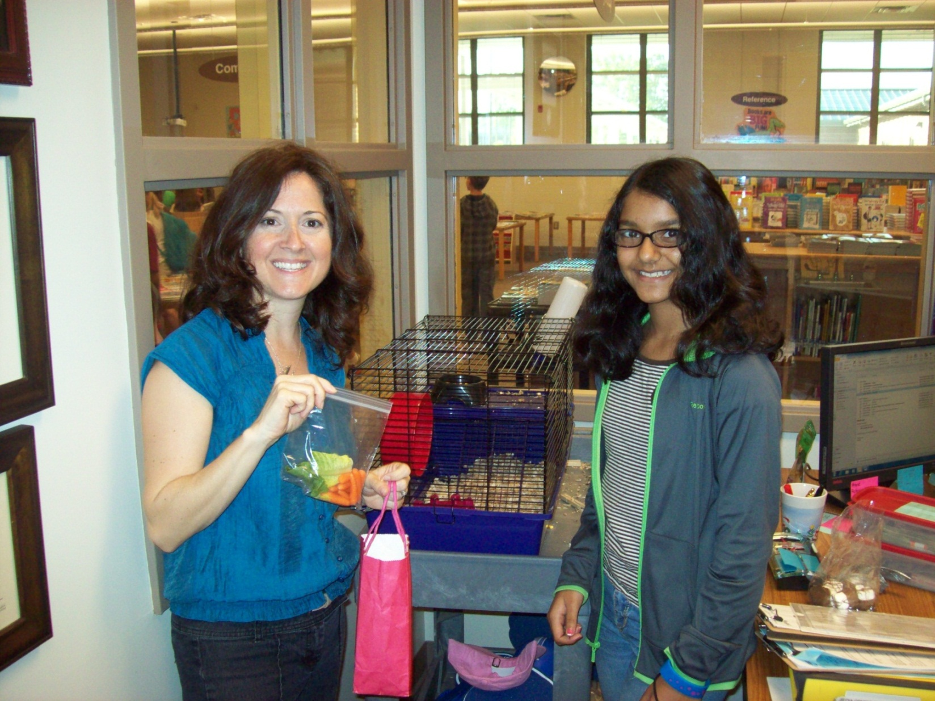
Goodies for Humphrey
Notes:
Kids had a blast bringing in treats for Humphrey!

Slide 30
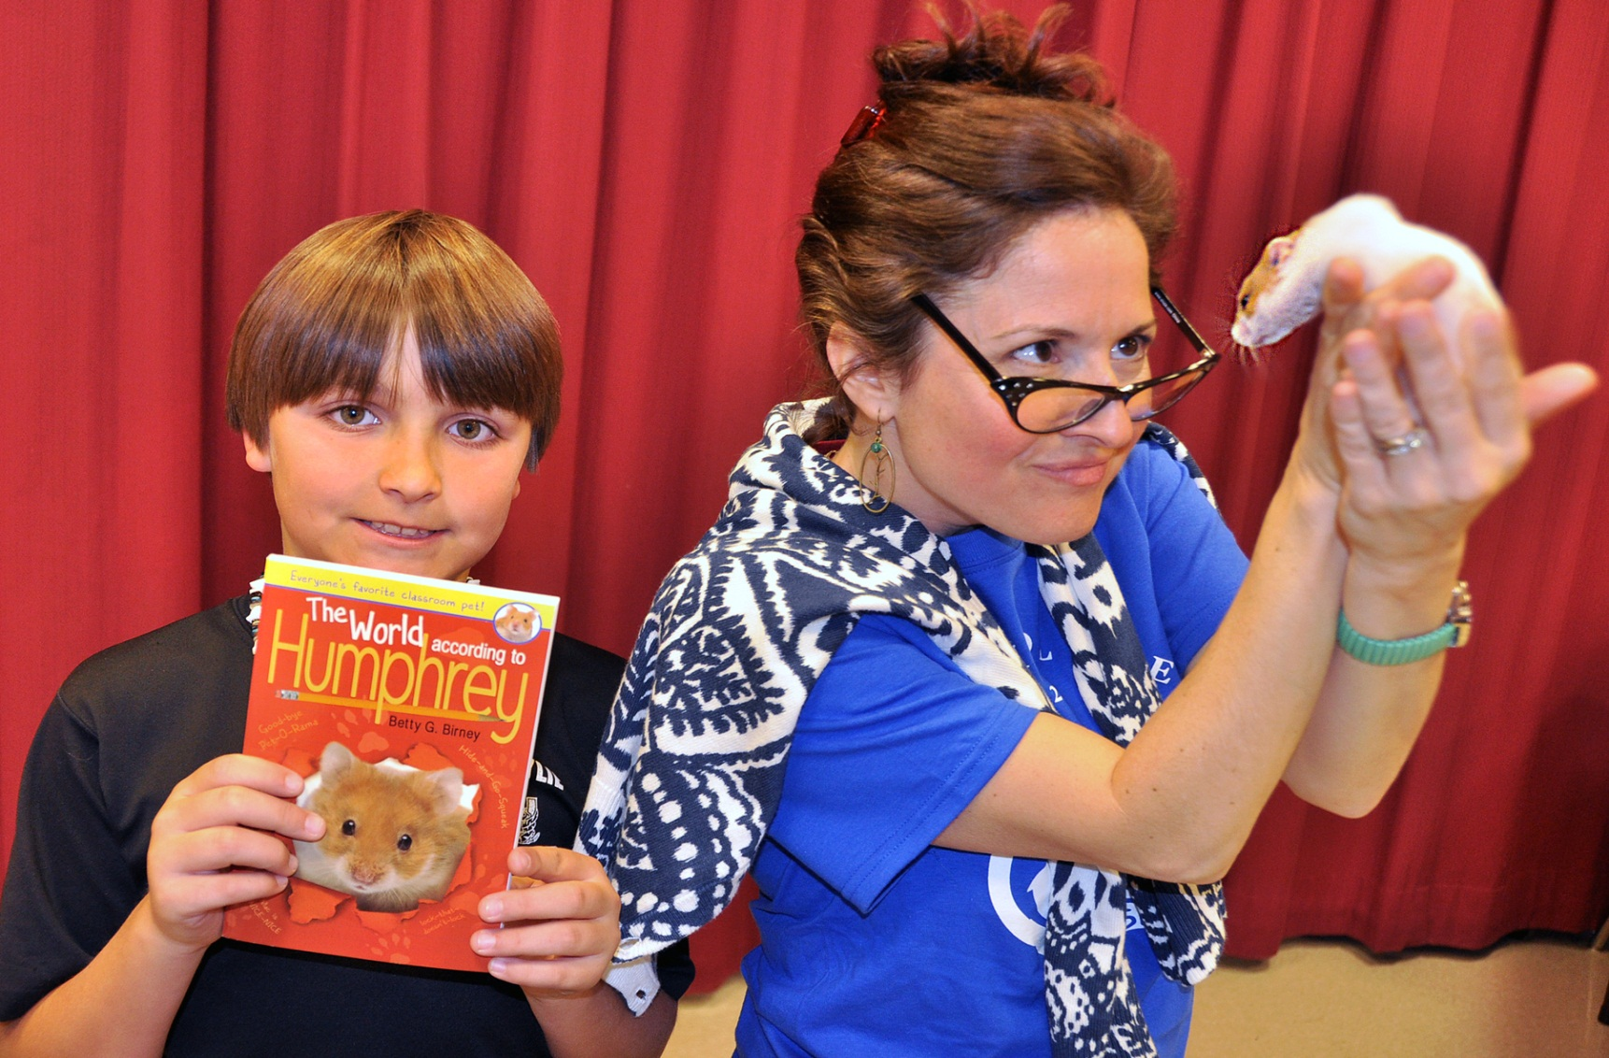
Bring Characters to Life
Does she really dislike Humphrey, or is it all an act?
Notes:
Mrs. Nees (kinda’) liked Humphrey, but it was work to keep his cage clean. Stephen helped every week.

Slide 31
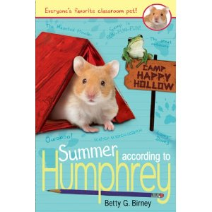
Summer Reading
Notes:
We sold over 100 Summer According to Humphrey books!

Slide 32
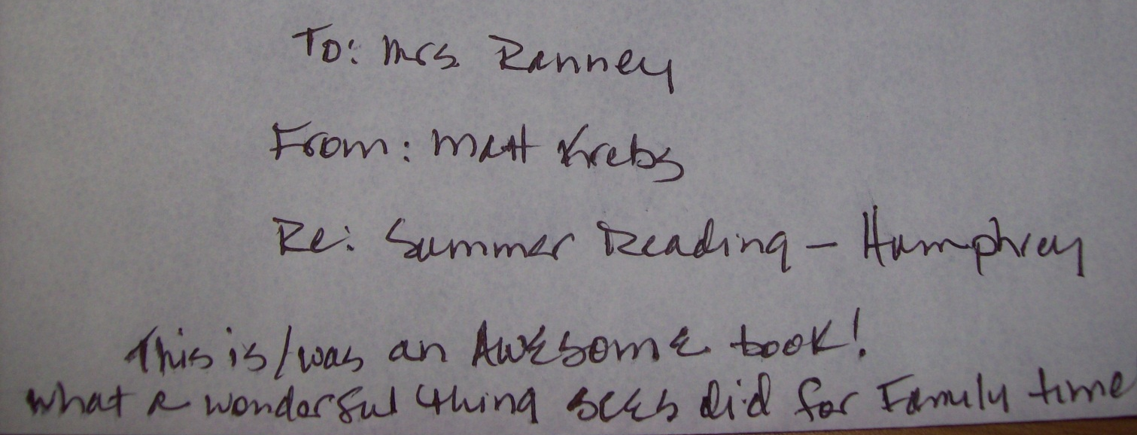
Response
Notes:
Tons of comments and this note from a parent about how it brought their family closer together.

Slide 33
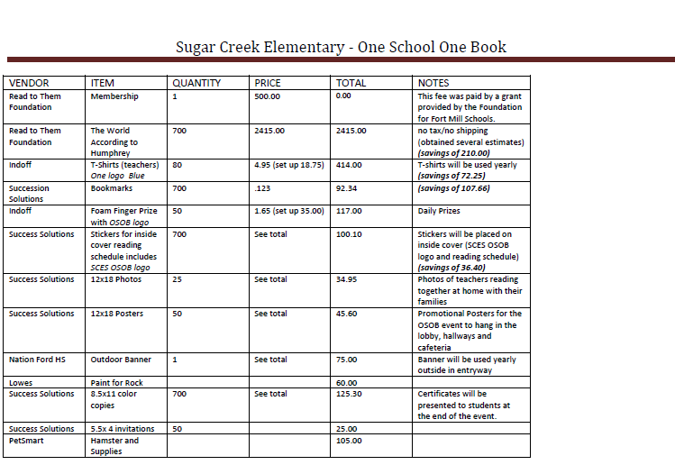
Budget
Notes:
Program total was just under $5000.00

Slide 34
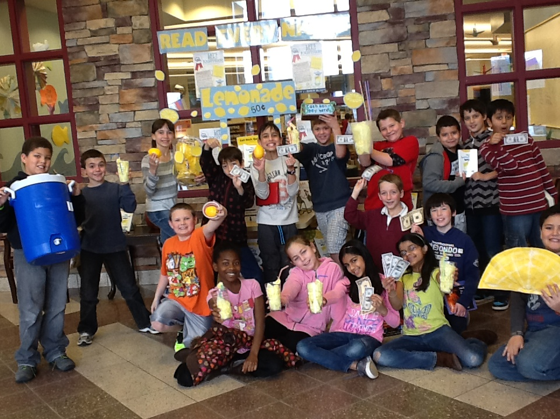
The Lemonade War
Year Two

Slide 35
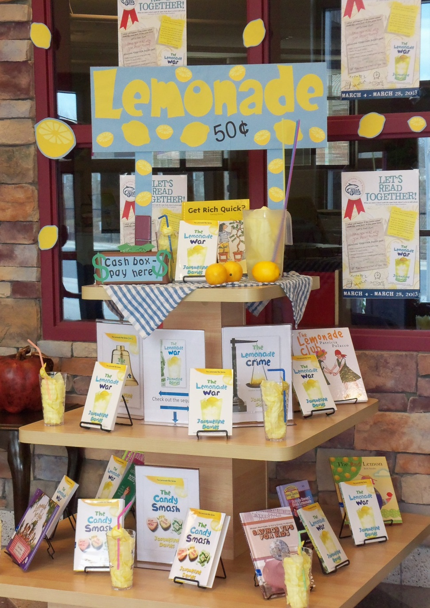
Before & After

Slide 36
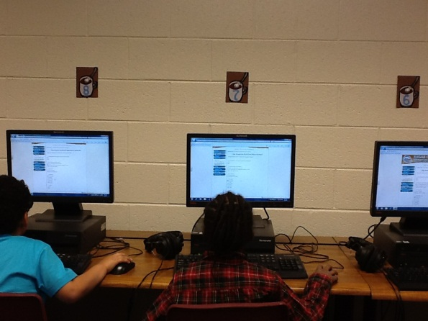
NetSCOPE Research and Inquiry Grant: Winthrop College
$$
Partner with Alma Elementary
Collect data
Publish Results
Questions
Did someone in your home read aloud to you yesterday?
How do you feel about reading?
Additional info collected: school, age, gender
Survey Link

Slide 37
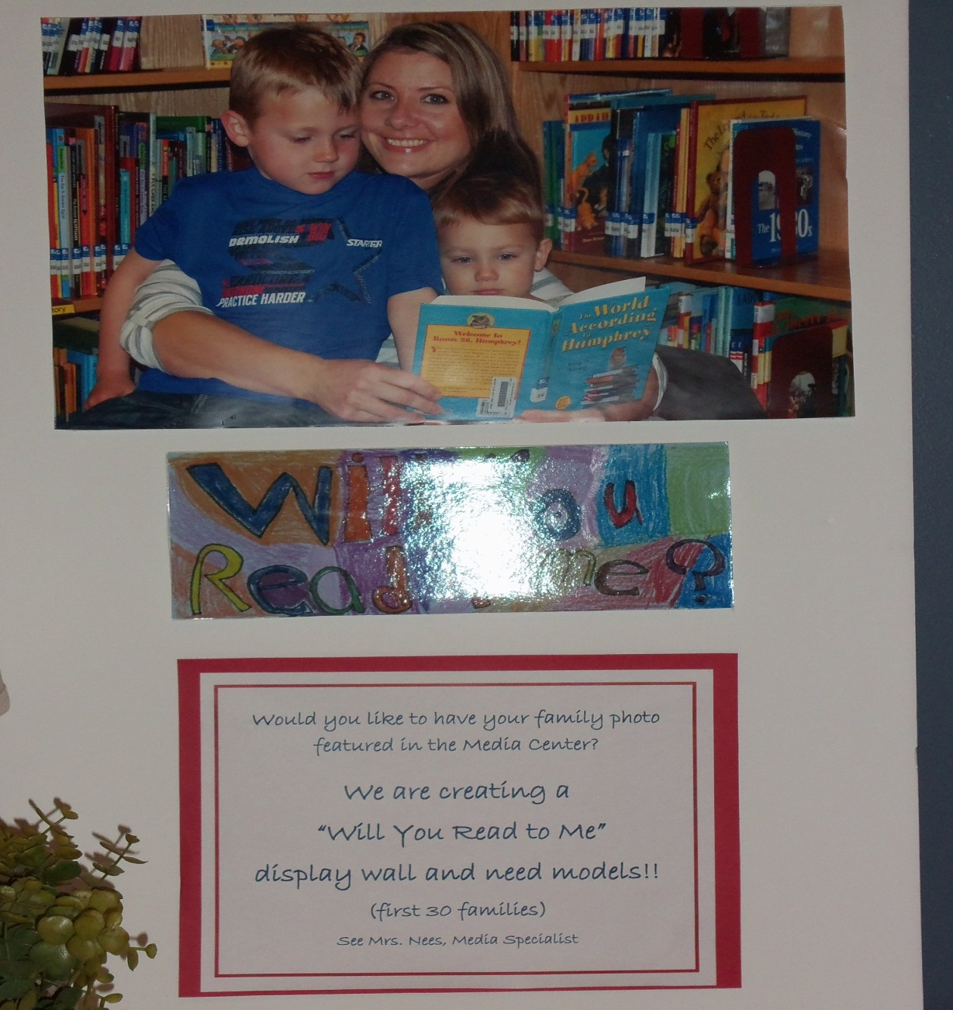
Will You Read to Me?
Modeling

Slide 38
Goals
Goals
Elementary School Involvement
One District One Book

